Slide 1
Lecture # 1
1 September 2020
Slide-02
Dr. A. Upadhyaya TA201T: Introduction to Manufacturing Processes

Slide 2
TA201T: Introduction to Manufacturing Processes
Course Objective...
Introduce fundamental concepts in Manufacturing
using Materials
You will learn about:
• various materials and their structure and properties
• how structure dictates properties
• how processing can change structure
This course will help you to:
• decide judiciously on the manufacturing processes
• realize new design opportunities with materials
TA201T: Introduction to Manufacturing Processes Instructor: Dr. Anish Upadhyaya

Slide 3
Course Content
Engineering materials
Microstructure processing relationship
Solidification processes
Molding and casting
Joining processes (Welding, Brazing and Soldering)
Deformation processes (Hot and Cold Working)
Powder metallurgy processing (Powder Production, Sintering)
Fe-C phase diagram and heat treatment
Surface modification (Carburization, CVD, PVD)
TA201T: Introduction to Manufacturing Processes Instructor: Dr. Anish Upadhyaya

Slide 4
The Materials Selection Process
1.
Pick Application
Determine required Properties
Properties: mechanical, electrical, thermal,
magnetic, optical, deteriorative.
2.
Properties
Identify candidate Material(s)
Material: structure, composition.
3.
Material
Identify required Processing
Processing: changes structure and overall shape
ex: casting, sintering, vapor deposition, doping
forming, joining, annealing.
TA201T: Introduction to Manufacturing Processes Instructor: Dr. Anish Upadhyaya

Slide 5
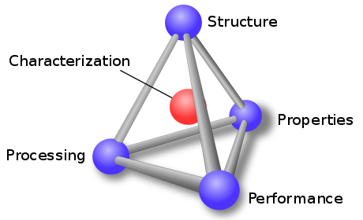
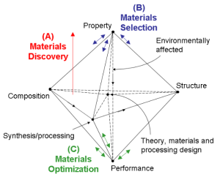
Materials Tetrahedron

Slide 6
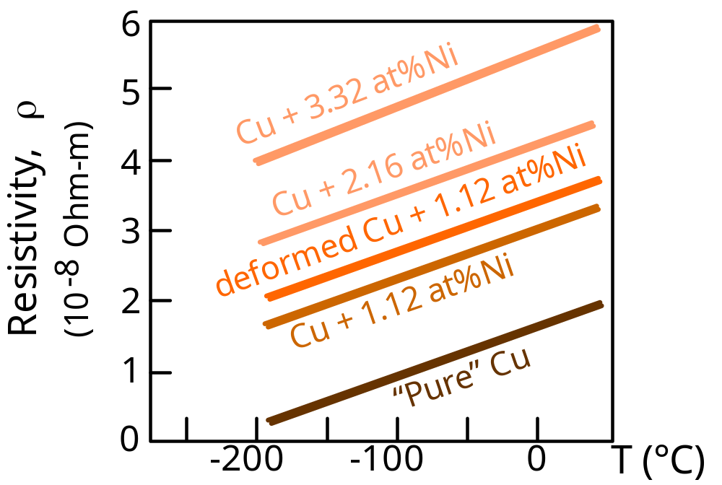
ELECTRICAL
• Electrical Resistivity of Copper:
(J.O. Linde, Ann Physik 5, 219 (1932);
C.A. Wert and R.M. Thomson,
Physics of Solids, 2nd ed.,
McGraw-Hill, New York,1970.)
• Adding “impurity” atoms to Cu increases resistivity.
• Deforming Cu increases resistivity.
TA201T: Introduction to Manufacturing Processes Instructor: Dr. Anish Upadhyaya

Slide 7
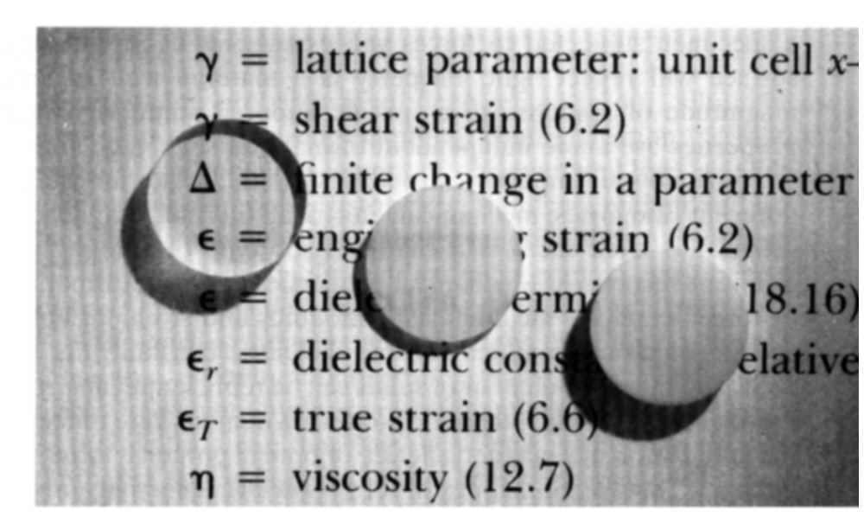
OPTICAL
• Transmittance:
--Aluminum oxide may be transparent, translucent, or
opaque depending on the material structure.
polycrystal:
low porosity
polycrystal:
high porosity
single crystal
Callister 6e
TA201T: Introduction to Manufacturing Processes Instructor: Dr. Anish Upadhyaya

Slide 8
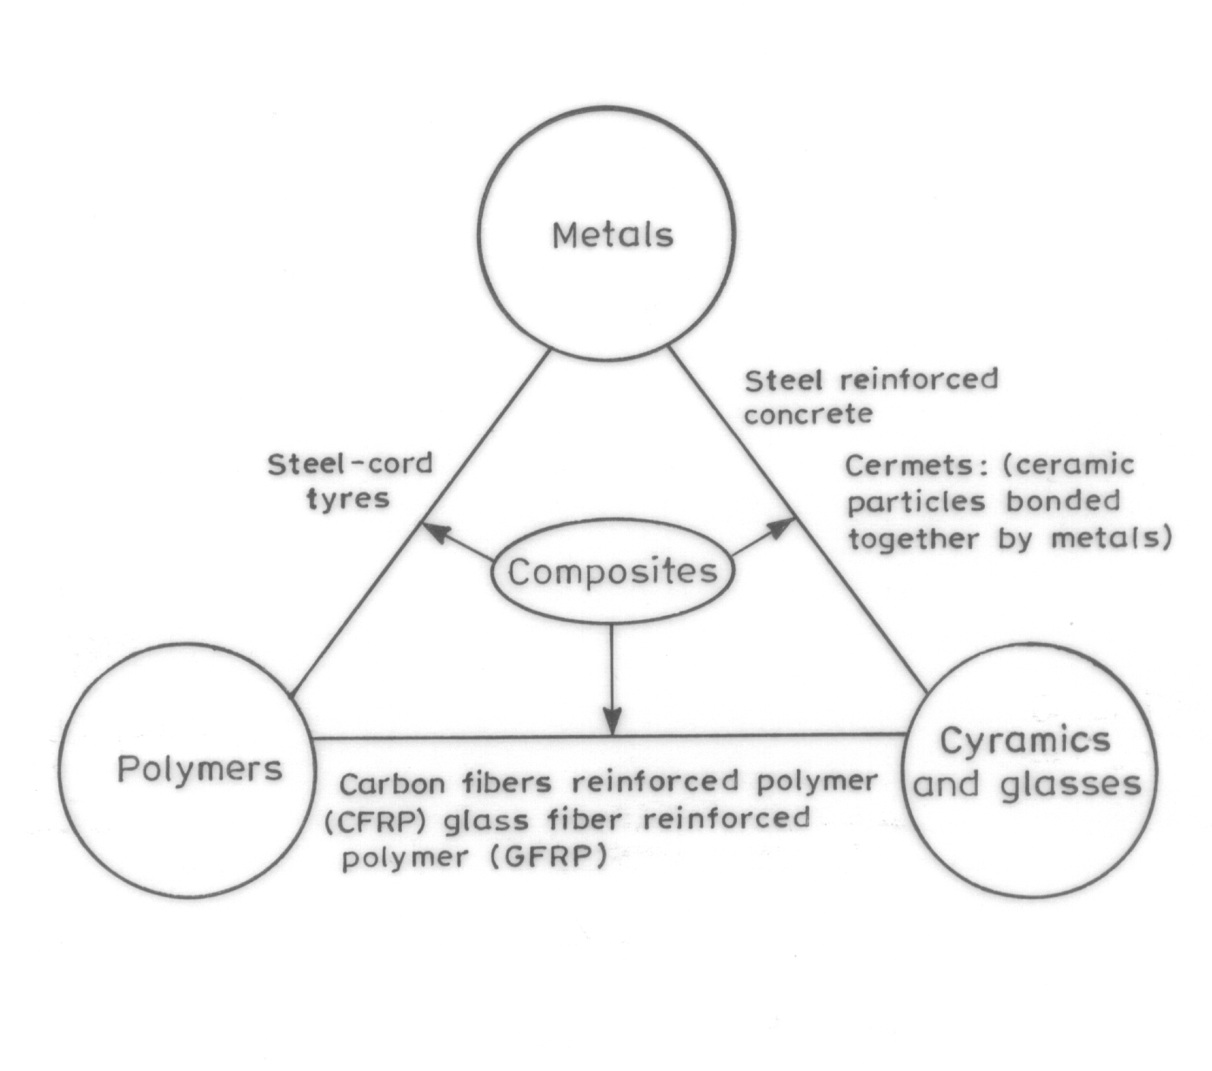
Classification of Various Types of Composites
with few illustrative examples
TA201T: Introduction to Manufacturing Processes Instructor: Dr. Anish Upadhyaya

Slide 9
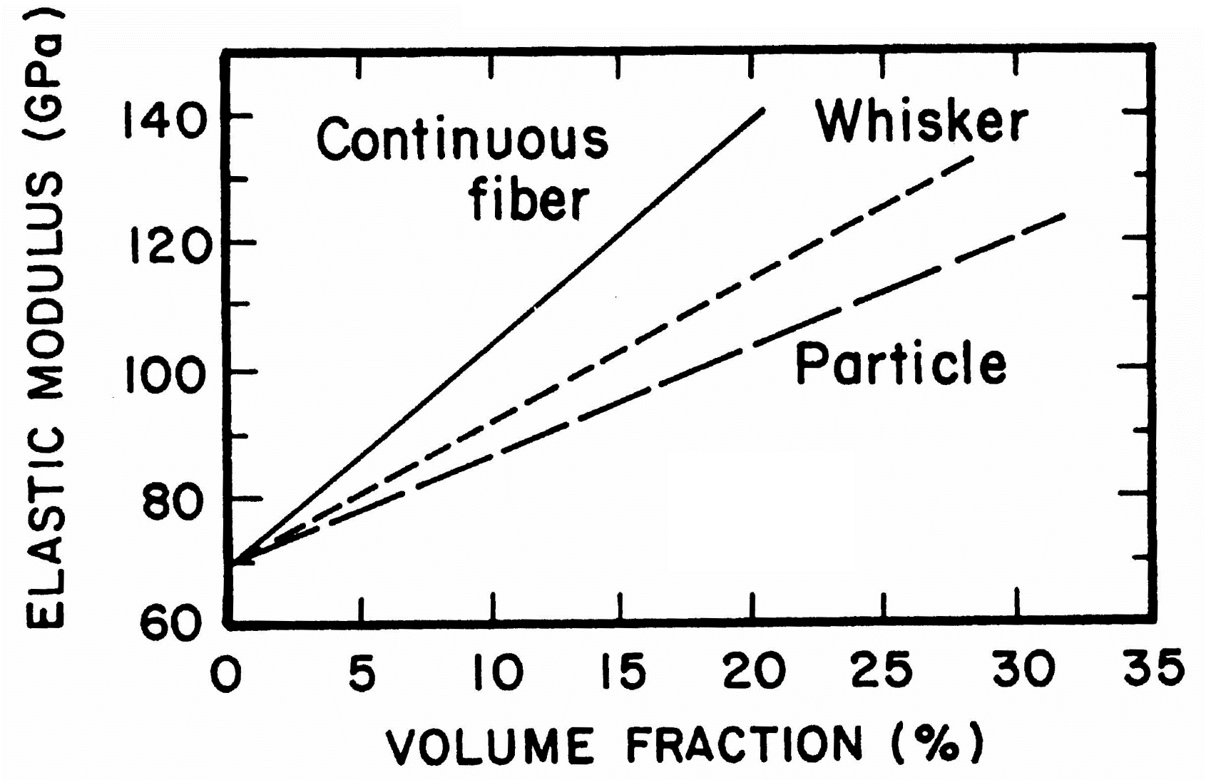
Variation of Elastic Modulus of Composites with Varying
Content and Morphology of the Reinforcing Phase
TA201T: Introduction to Manufacturing Processes Instructor: Dr. Anish Upadhyaya

Slide 10
Selection Criteria for Manufacturing Processes
Manufacturing cost
Production volume and production rate
Characteristics and properties of work piece
Limitations on shape and size
Surface finish and tolerance requirements
Functional requirements of the products

Slide 11
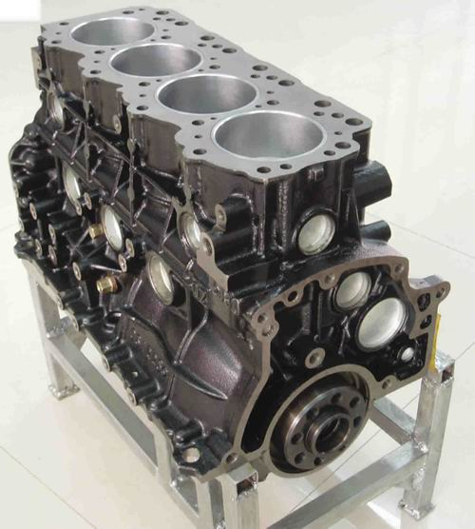
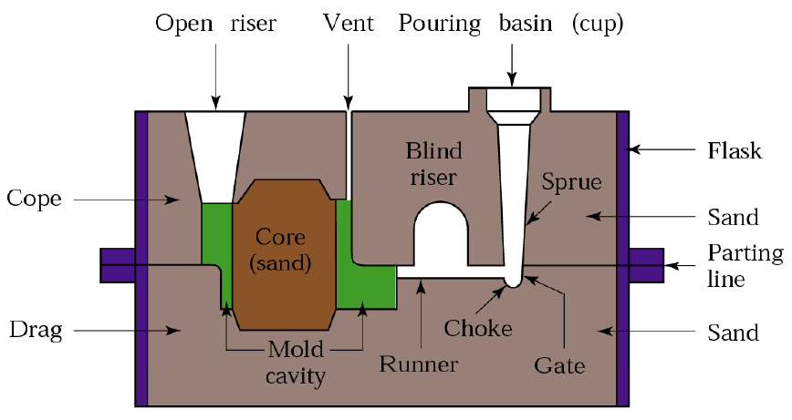
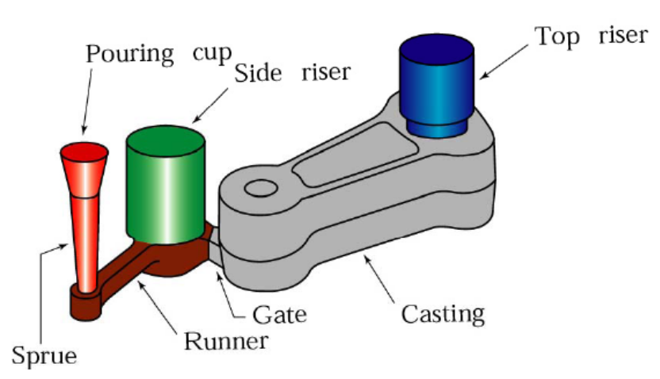
How would you make Engine block?
Look at the complication and
intricate design of engine block

Slide 12
Sand Casting Steps
Sent to supplier
Pattern making
(Pattern shop)
Sand blasting and
Machining (finishing)
Design section
Shake out
raw casting out
Sand making
(Sand Plant)
Mold making
Core making
(core shop)
Core assembling on mold
Pouring
Metal making
(Melting shop)
Transfer of metals
To Pouring station
Pouring ladle
Quality control

Slide 13
Some Videos
Sand casting Video
http://www.youtube.com/watch?v=rgL2Jn5mk1A
gas welding
http://www.youtube.com/watch?v=9P_QhTOnknQ
Oxy-acetylene
http://www.youtube.com/watch?v=DWJQudCiUes&feature=related
Brazing and welding
http://www.youtube.com/watch?v=TQP8EBQRvr0
welding safety
http://www.youtube.com/watch?v=MVrI2kuRKdA&playnext=1&list=PLC415ABDC4A196A9D
Open die forging
http://www.youtube.com/watch?v=tLRkOupbARM

